Slide 1
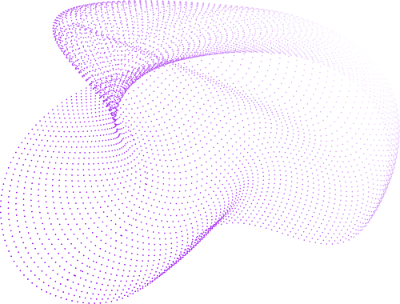

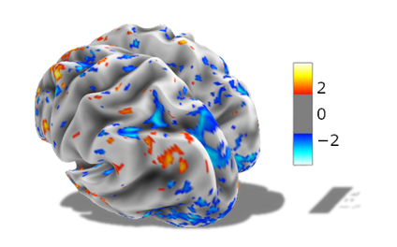
Engagement of personalized resting brain states during inter-task intervals predicts working memory task performance in healthy adults
Interstate Mindways

Slide 2
Team Members
Amber Howell (Rutgers University, New Brunswick, NJ)
Lucas Wozniak (Stanford University, Palo Alto, CA)
Madison Jiang (University of Texas at Dallas, Dallas, TX)
Marina Lemus Pérez (National Autonomous University of Mexico, Mex)
Mohamed Elnefary (Cairo University, Giza, Egypt)
Muzna Mehmood (National University of Sciences & Technology, Islamabad, Pakistan)
Pragata Ghosh (All India Institute of Medical Sciences, New Delhi, India)
Sachpreet Singh (Government Medical College, Patiala, India)
Sara Garza Gonzalez (Georgetown University, Washington, DC)

Slide 3
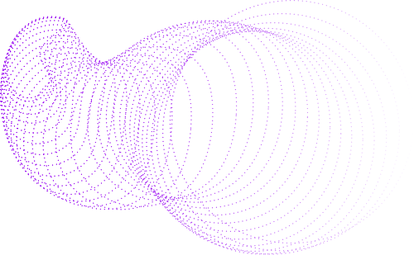
Background
Most fMRI studies average brain activity over time, thereby hiding brief activation and connectivity changes
Some studies have observed rapid changes in brain states during and between task blocks
Healthy adults have been shown to enter resting-state-like brain patterns during brief inter-task intervals
What is a brain state?
An emergent, distributed pattern of activity or coupling across the brain that is dynamically engaged depending on temporal and situational context

Slide 4
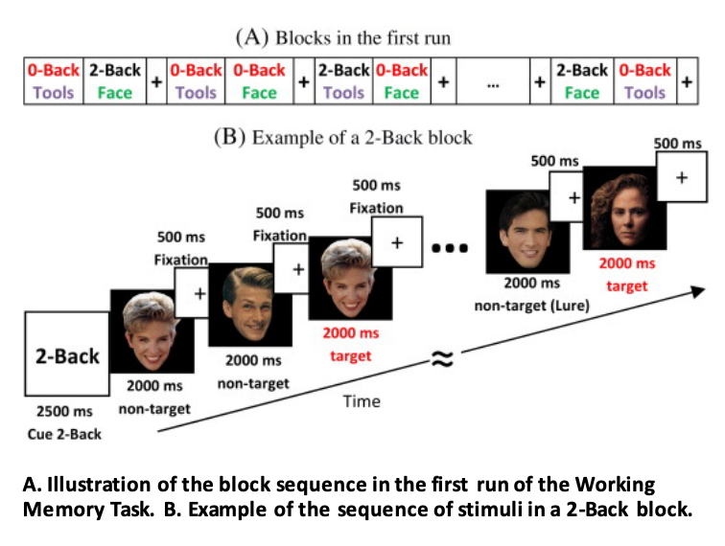

Slide 5

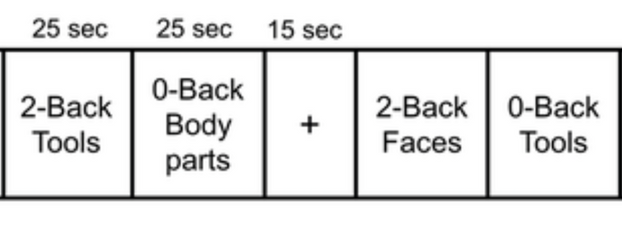
Questions
Do subjects preferentially engage specific rest-like brain states during inter-task intervals?
Are these states related to the subjects' performance on a working memory task?

Slide 6
Hypothesis
Subjects whose inter-task interval activity re-engages particular rest-like brain states will exhibit better performance (higher accuracy rates and lower reaction times) on 2-back working memory block conditions.

Slide 7
cont.
Research showed transient resting-state-like brain activity between task blocks in fMRI.
Research has also defined key resting-state brain patterns in healthy adults, including the primary sensorimotor-to-association gradient and a small set of recurring activation states.
It is unknown whether individuals are biased toward specific brain states during task transitions and how this relates to their performance on a working memory task.

Slide 8
cont.
Secondary Objectives
1. Determine if canonical resting-state patterns persist or transform during diverse HCP tasks
2. Predict individual task performance (accuracy/RT) using state dynamics (dwell time, entropy, transitions)
3. Model behavioral relevance of dynamic states via linear and deep learning approaches

Slide 9


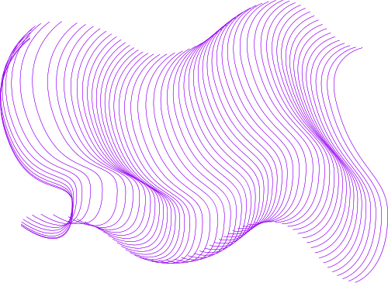
Methods
Dataset
HCP: 339 healthy adults
Resting-state + WM task fMRI
Preprocessing
Standard HCP pipeline
Cortical parcellation
Data Concatenation
Combined rest time-series compared with combined WM block time-series
Created subject-specific matrices
(brain region × time)
Madison

Slide 10
Timeline /Pipeline
Step 1: Extract Brain States
Used resting-state fMRI data
Methods:
PCA on time series/FC
HMM
t-SNE + k-means
dynamic FC
Step 3: Compare Behavioral Performance across Groups
Kruskal-Wallis Test for significance
Compare final results from each method to select which method identified most informative brain states
1.2: Compare & Select Most Informative Method
Brain states from each method correlated to find unique states
Feed through rest of pipeline
Strong correlation between brain state & WM performance = most informative method
Step 2: Label Time Series per Brain State During Inter-task Intervals
Extract TRs of the Inter-task intervals
Label WM time-series’ TRs as each respective brain state
Assign the subject to most common brain state
Madison

Slide 11
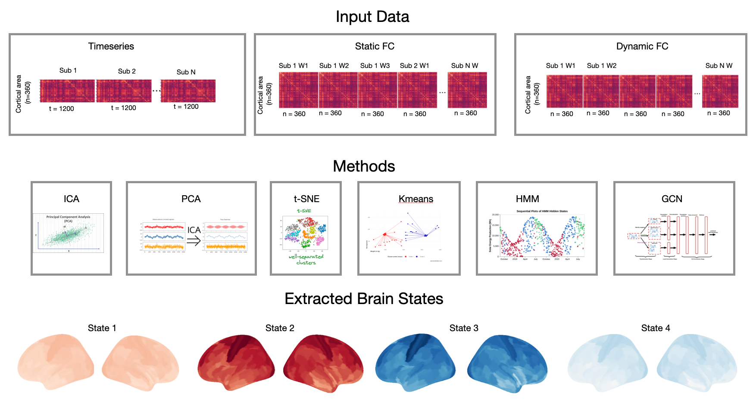

Slide 12
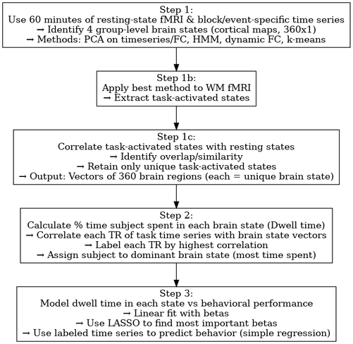
Cont.
Dwell Time Metrics
% time in preferred state
State transition entropy
Behavioral Modeling
Linear models: dwell time → performance
Optional: ML approaches (e.g., SVM)
Validation
Split-half reproducibility
Confound regression (e.g., head motion)

Slide 13
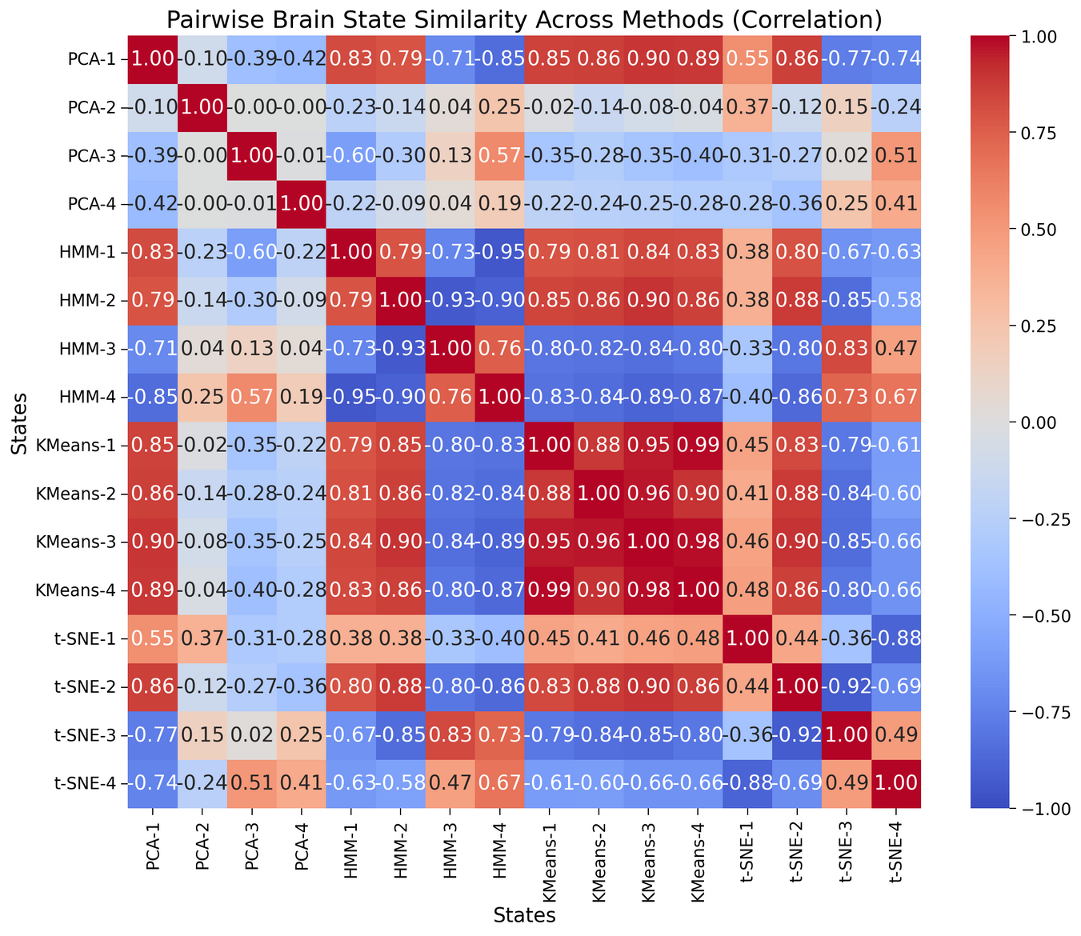

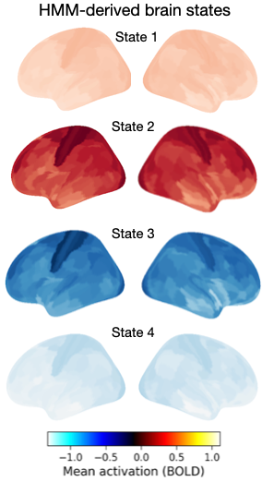
Result 1: Data-driven approaches identified shared and unique brain states across methods during rest.

Slide 14
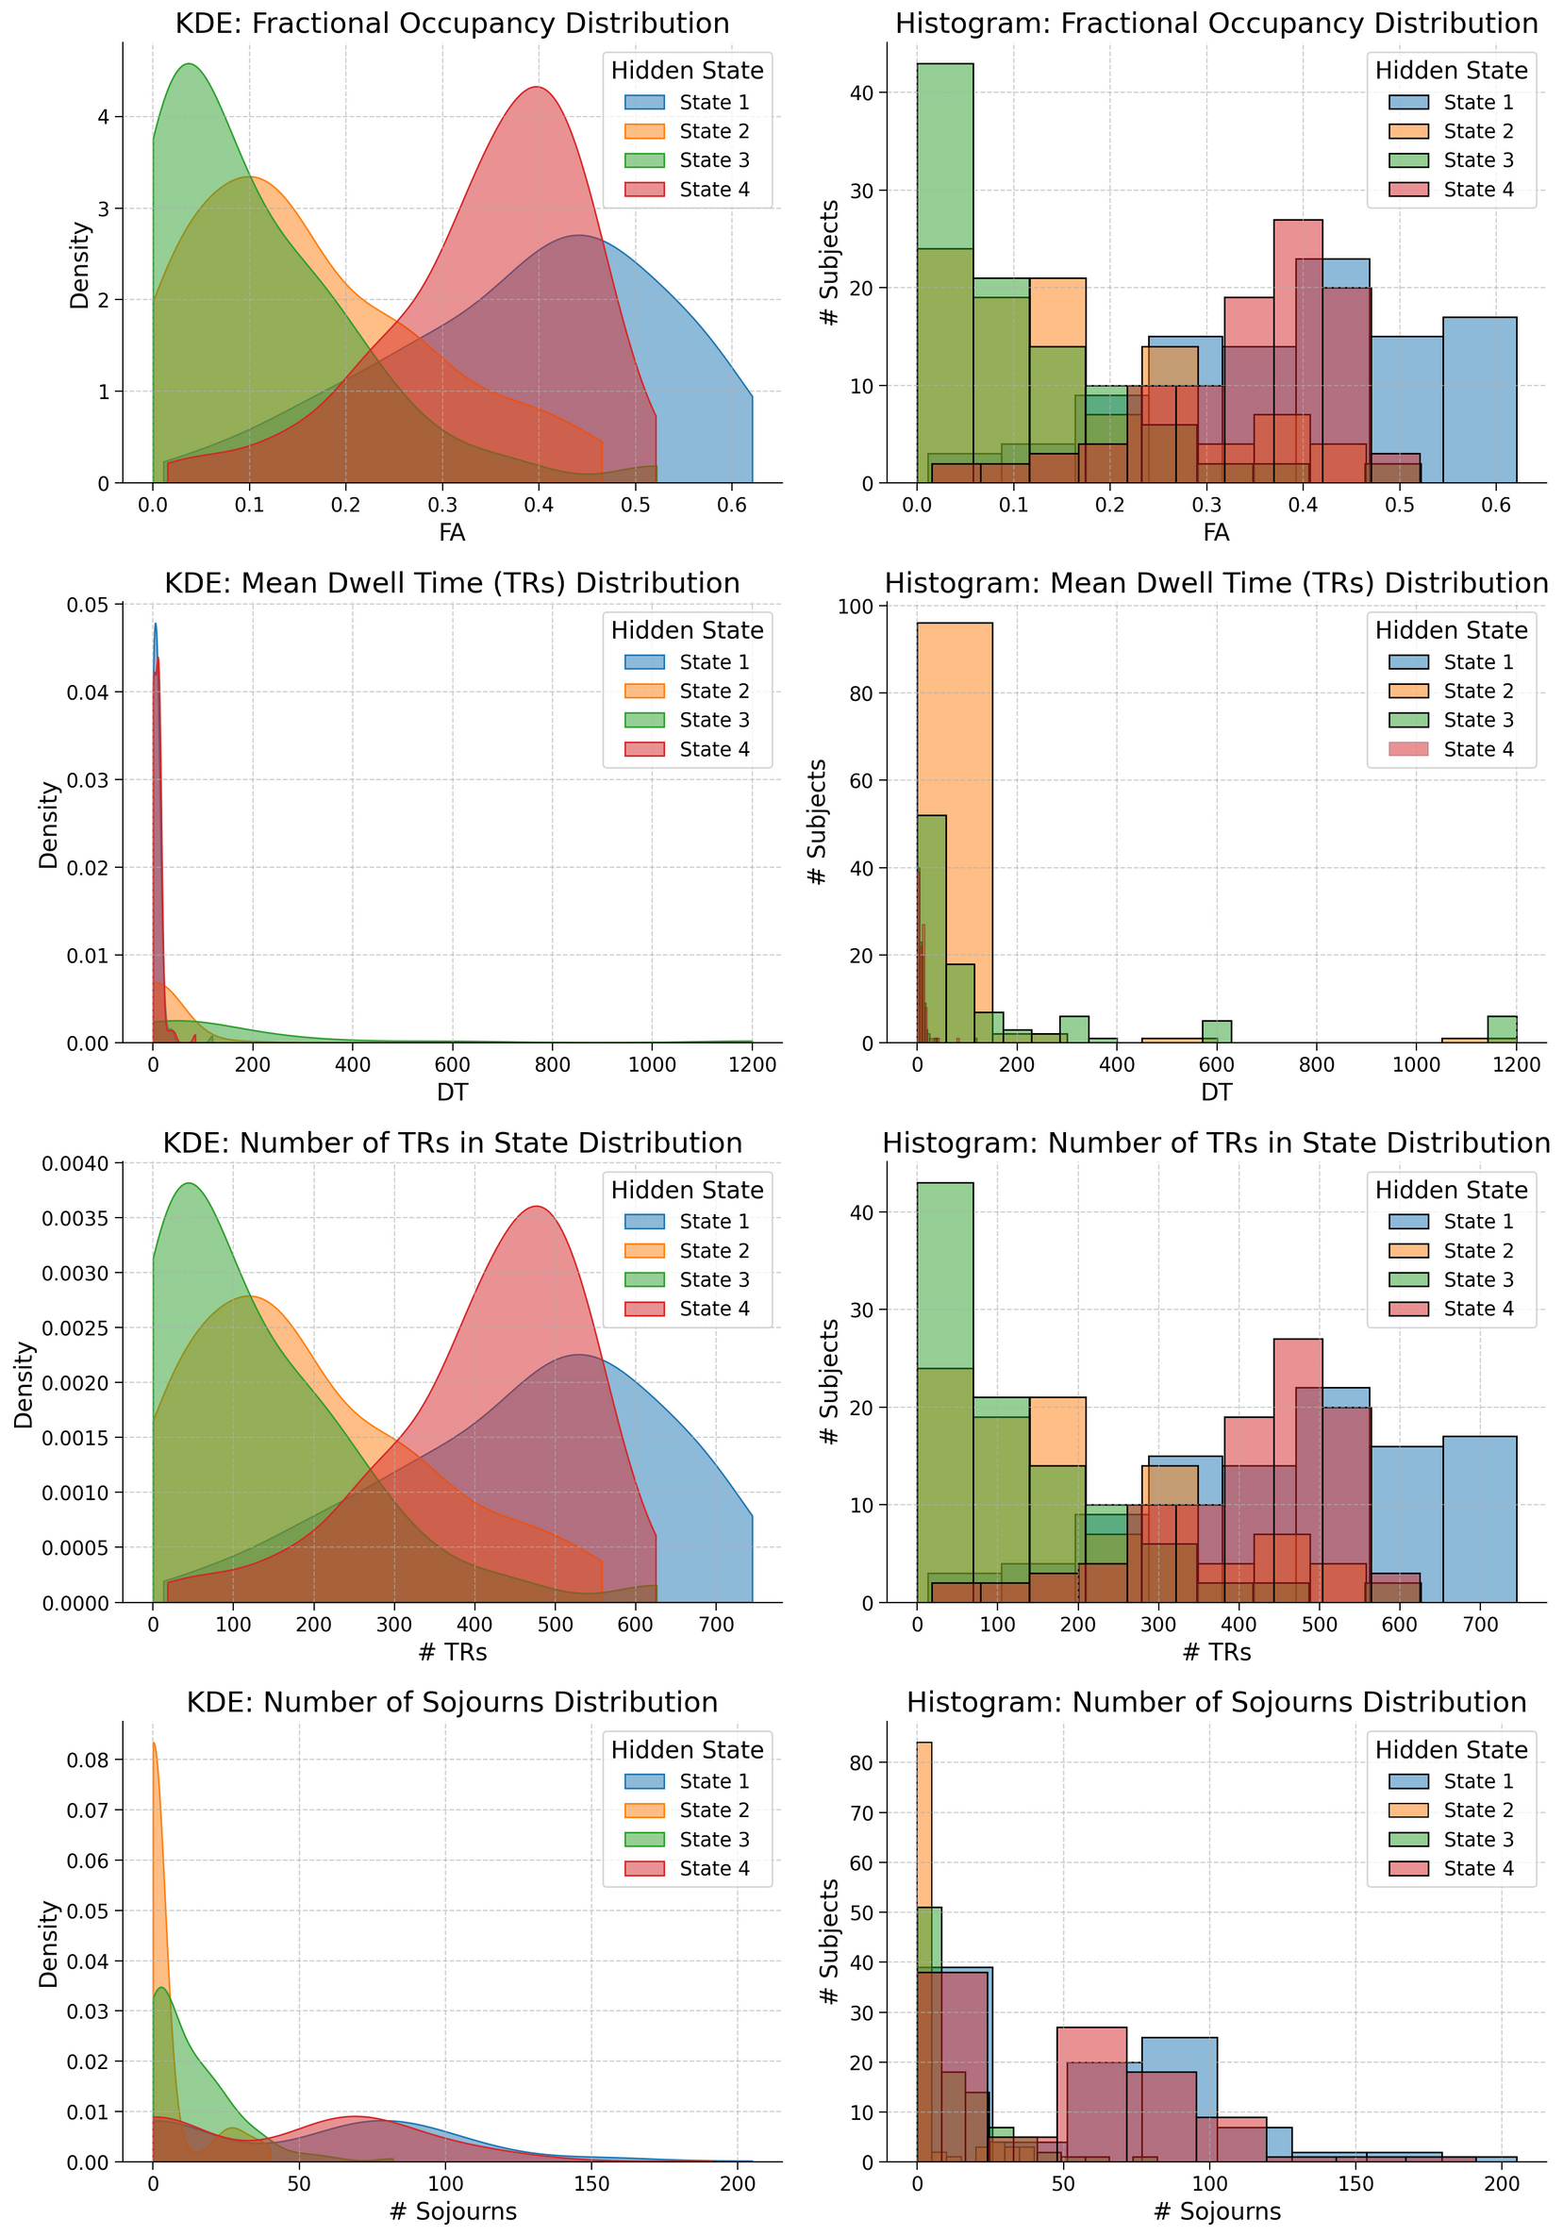
Result 2: Our HMM identified a set of transient, high-frequency brain states and a set of stable, longer lasting brain states.

Slide 15
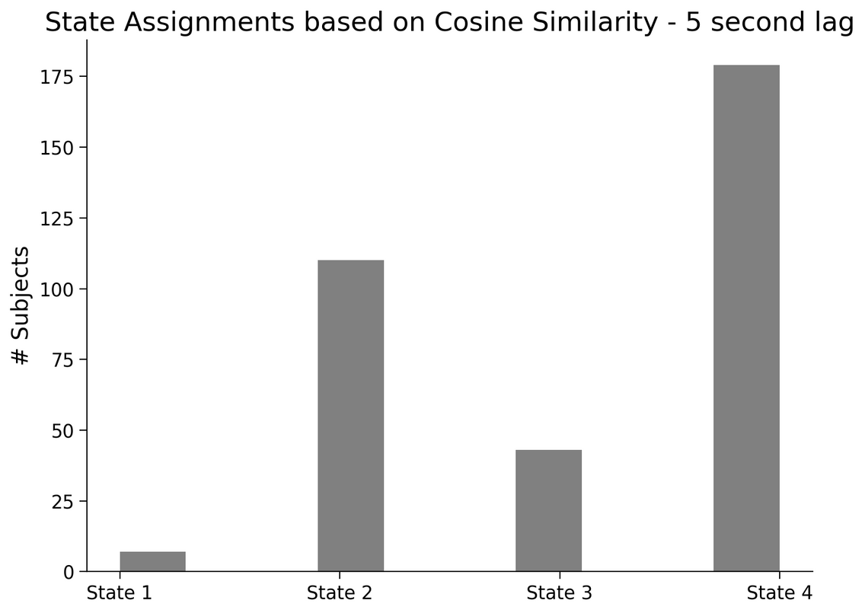
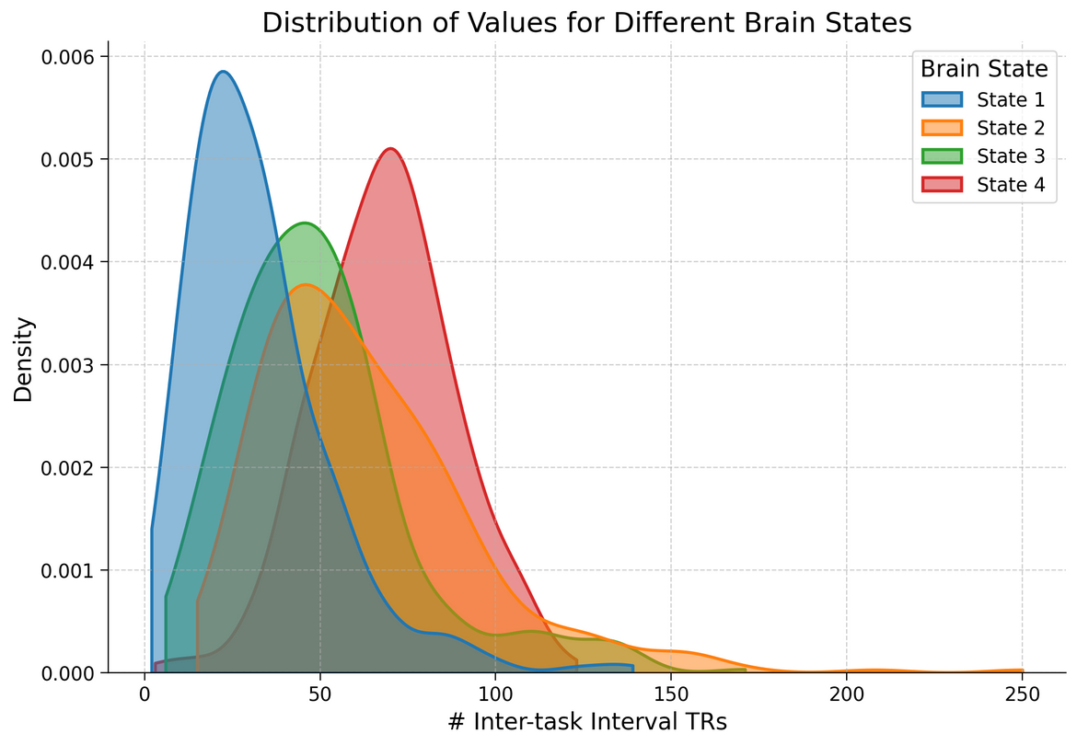
Result 3: During the WM task, subjects preferentially engaged distinct resting brain states during inter-task intervals.

Slide 16
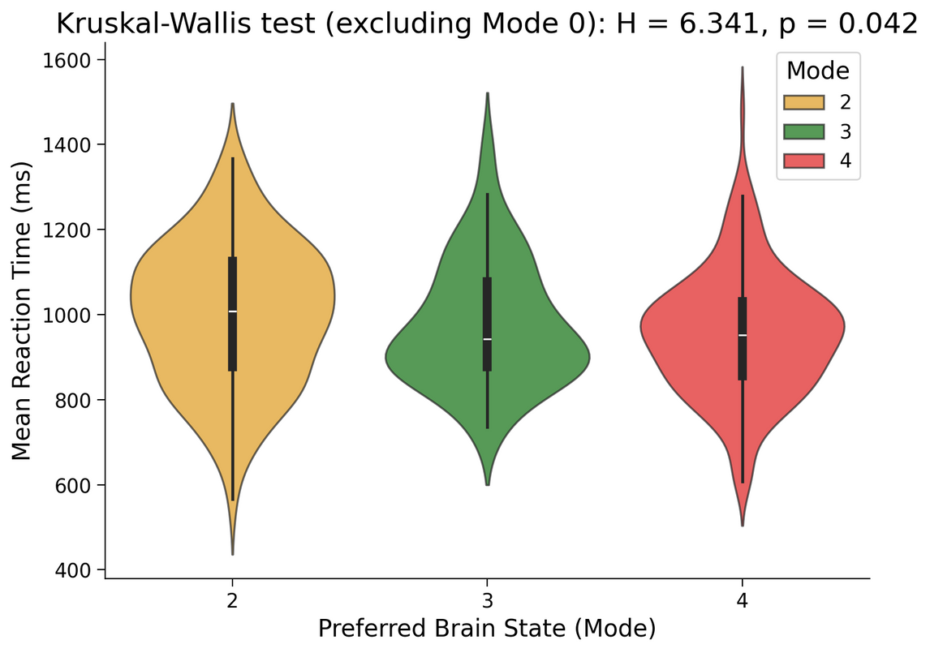
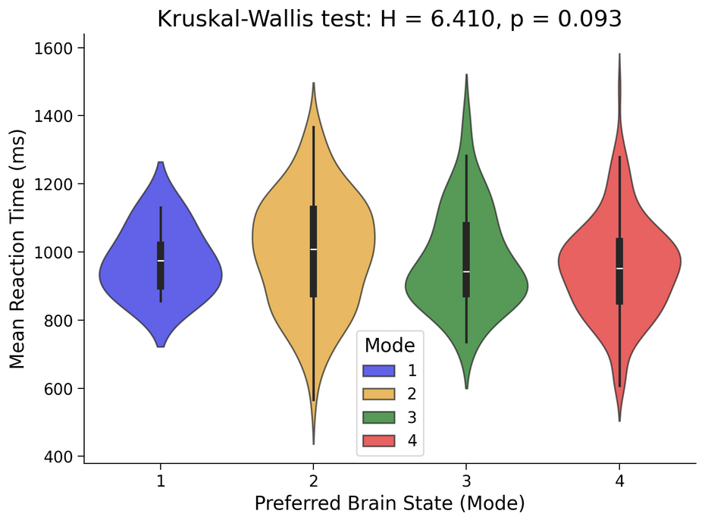
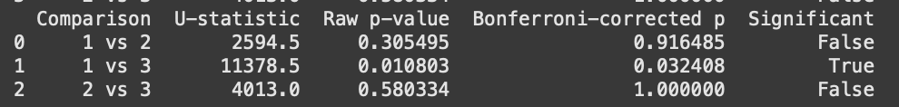
Result 4: Subjects exhibiting global disengagement during WM inter-task intervals demonstrated faster RTs in the 2-Back WM task.

Slide 17
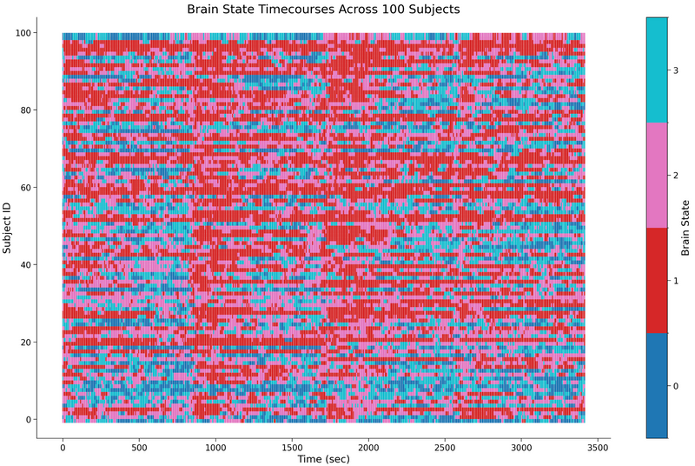
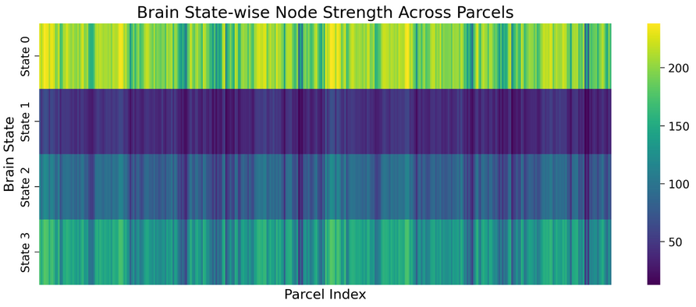
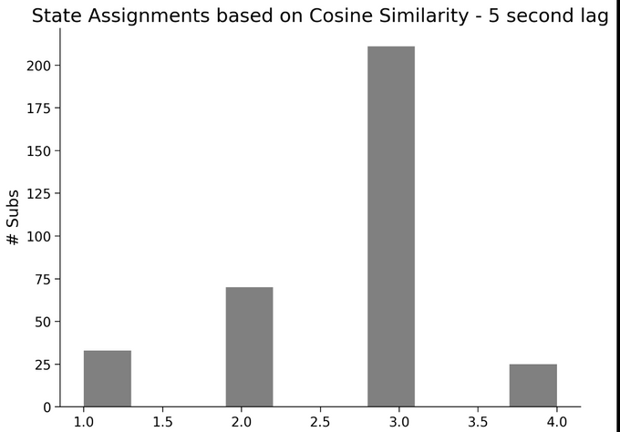
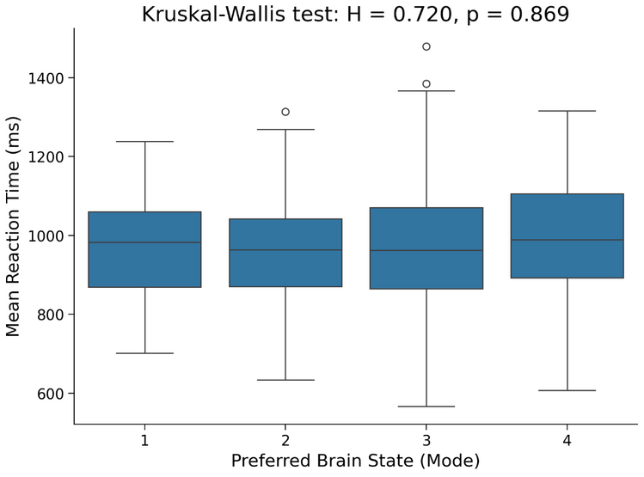
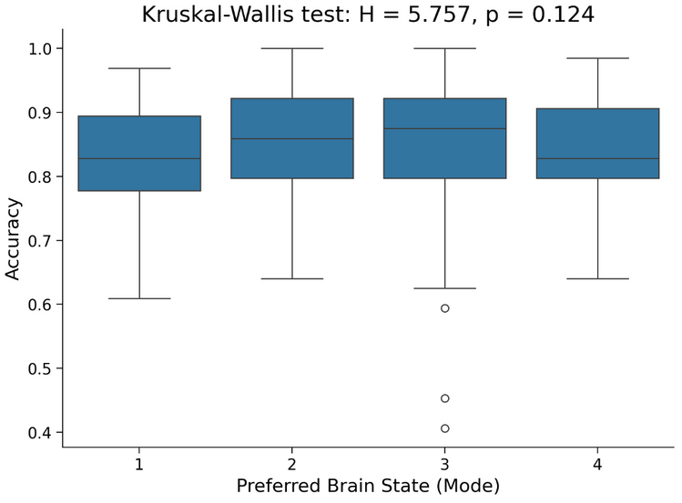
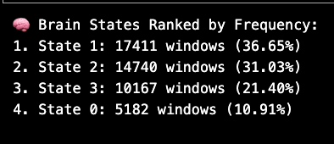
k-means on dFC: prelim results

Slide 18
Conclusion
Collectively, these findings highlight that the dynamic engagement of specific, global resting brain states during inter-task intervals relates to working memory performance.
Notes:
By implementing such innovative methods,
we were able to find numerous ways for defining brain states during inter-task intervals,
and how these influence performance on working memory tasks.

Slide 19
Limitations
& Future Directions
Further examination of across-method differences in brain state extraction needed
Mostly only ran analyses for first 100 subjects because of computational constraints
Not all TRs in the time series were perfectly aligned with stimulus blocks
Compare resting vs. task brain states
Notes:
however, because we used multiple methods, we don't have enough data to support one specific conclusion
in other words, since we ran a bunch of different methods, we did not have enough time to conduct comparisons across these and have one concrete, detailed way of defining brain states for our specific RQ
although we had enough variation in our methods to get specific about how brain states look like, more examination is needed to understand what these mean
for instance, one way to define them could be by seeing which techniques yield the most stable or consistent brain states across each other,
or by seeing which ones show strongest neurobehavioral relationships, such as linking task performance with brain states

Slide 20
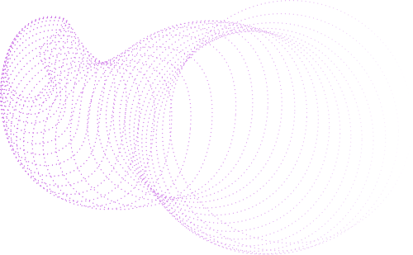

Maybe the answer lies not in how hard we try, but in how the brain quietly tunes itself in the in-between ...
In the silence between tasks, a pattern forms ...
subtle, dynamic, personal.
And that pattern may shape how we perform when the world resumes its demands ...

Slide 21
References
Fair DA, Schlaggar BL, Cohen AL, et al. A method for using blocked and event-related fMRI data to study "resting state" functional connectivity. Neuroimage. 2007;35(1):396-405. doi:10.1016/j.neuroimage.2006.11.051
Margulies DS, Ghosh SS, Goulas A, et al. Situating the default-mode network along a principal gradient of macroscale cortical organization. Proc Natl Acad Sci U S A. 2016;113(44):12574-12579. doi:10.1073/pnas.1608282113

